Slide 1
Testing with TestComplete
Igor Gershovich
Connected Testing, Inc.
www.connectedtesting.com
igershovich@connectedtesting.com

Slide 2
Overview
About TestComplete
Types of Testing with TestComplete
TestComplete vs. HP/Mercury QTP
Data/Keyword-driven automation

Slide 3
1. About TestComplete

Slide 4
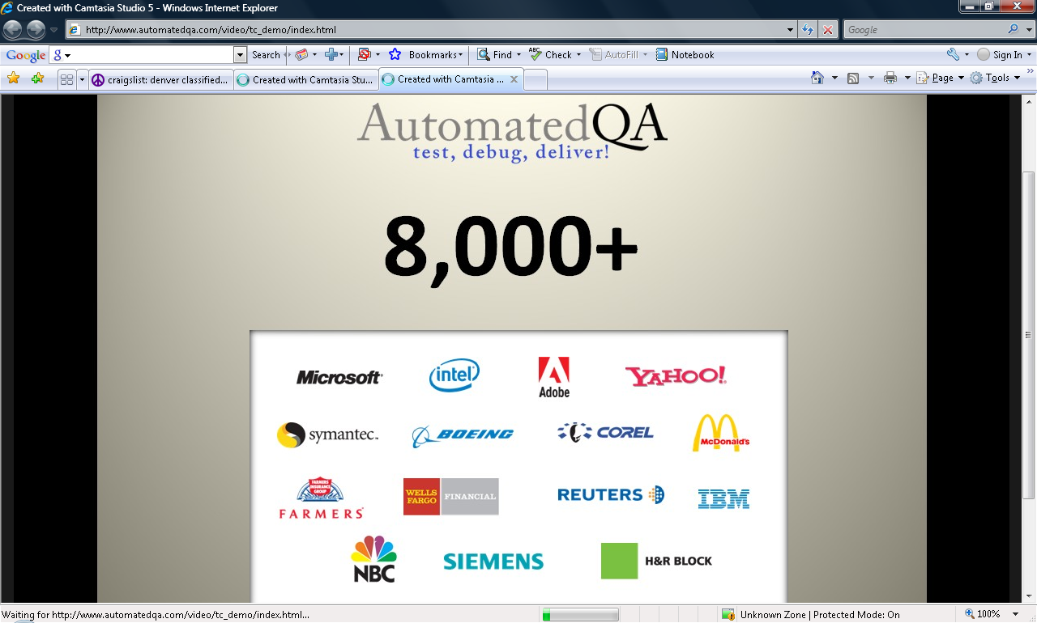

Over 8000 companies own AutomatedQA products

Slide 5
…It’s easy to get started with TestComplete, but to take full advantage of everything that it has to offer you need not only to understand the built-in functionality, but you also need a deep knowledge of your testing trade and software development best practices…
Atanas Stoyanov
Original Founder of AutomatedQA

Slide 6
Automated Testing
TestComplete is an automated testing environment for Win32, .NET and Windows Presentation Foundation (WPF) applications.
TestComplete provides extended support for testing Web Pages, Web Servers, Web Services and Projects created in the following development tools:
  Microsoft Visual C++/Borland C++ Builder
  VB
  Delphi
  Java
  .NET
  WPF

Slide 7
TestComplete IDE
TestComplete IDE includes:
Test Project Management
Test Execution tool for both manual and automated test cases
Reporting
Web Load/Performance tool

Slide 8
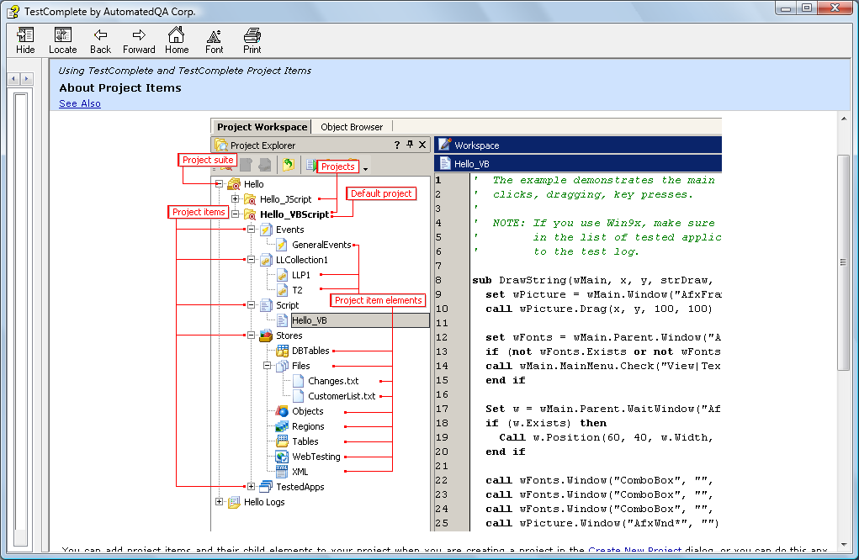
TestComplete Project Workspace

Slide 9
Supplementary Applications
TestExecute is CLI utility allows to execute scripts written with TestComplete and log test results on machines without TestComplete installed.
TestRecorder is a set of runtime libraries to be distributed with your 32/64-bit applications. TestRecorder records end-user actions in the binary format that can be converted with TestComplete to scripts.

Slide 10
2. Types of Testing with TestComplete

Slide 11
Testing types
Automated
  Web
  HTTP Load/Performance
  Web Services
  GUI (Win32, .NET)
  Unit
  Distributed
Manual
Coverage with AQTime

Slide 12
Web Testing
Web Testing and Firefox Support plug-ins are included in Enterprise edition
Browsers:
  Microsoft Internet Explorer ver. 5 - 7.
  Mozilla Firefox ver. 1.5.0.1 - 3.0.
  Any web browser based on the Microsoft WebBrowser control.
  Netscape Navigator ver. 8.1.2 – limited support

Slide 13
Web Testing – Tree Models
The web tree models define how elements of the tested web page are shown in the Object Browser panel and how they are addressed in scripts
Tree Models:
  DOM - HTML elements are in the form of Item(index)
  Tag – same form as DOM but sorted by type
  Tree - HTML elements have the form ObjectType(Index), for example: Panel(0) - div element, Image ("Logo.gif") - image element
  Hybrid (DOM+Tree)

Slide 14
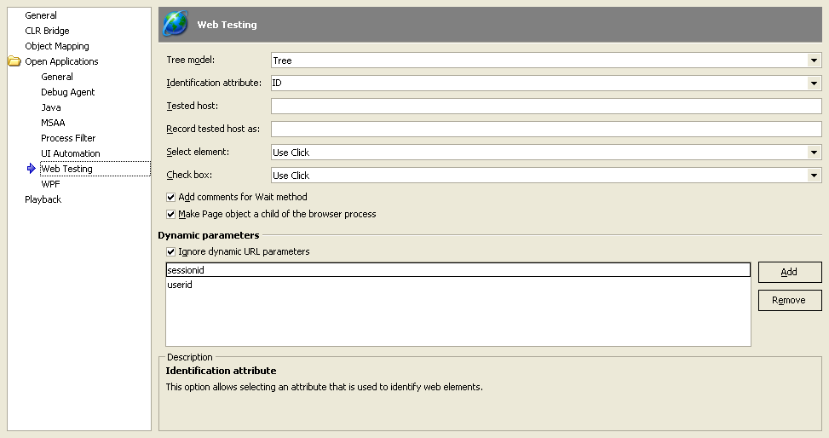
Web Testing settings

Slide 15
HTTP Load/Performance
HTTP load testing is only included in Enterprise edition
TestComplete can record and reproduce HTTP/HTTPS and SOAP requests that send to Web servers or Web Services
Remote Agent is a tool that allows for the distribution of HTTP loads tests across a network of computers

Slide 16
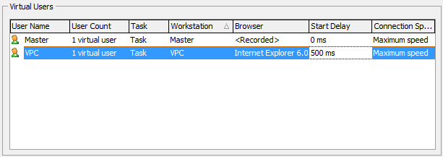
Distributed Load Testing setting

Slide 17
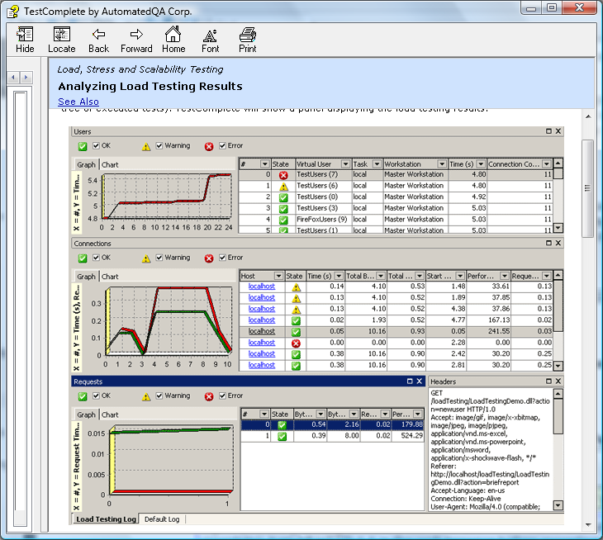
Load Testing results

Slide 18
Web Service testing against WSDL
1. Add the Web services project item to your project
  a. Right-Click on the project, select Add | New Item… from the context menu.
  b. Select the Web services project item
2. Add a Web Service project item to the Web services Project Item.
  a. Right-Click the newly added Web services project item and select Add | New Item… from the context menu.
  b. Name the Web Service project Item and click the OK button.
3. Select the WSDL file for the web service.
  a. Click the Select button for the Web Service Definition URL.
  b. Enter the URL (location) to the web service.
  c. Click the Get Services button.
  d. Select the Web Service to test from the drop down list.

Slide 19
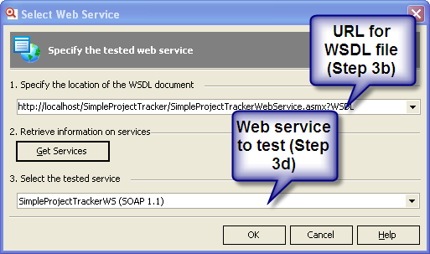
Web Service testing against WSDL

Slide 20
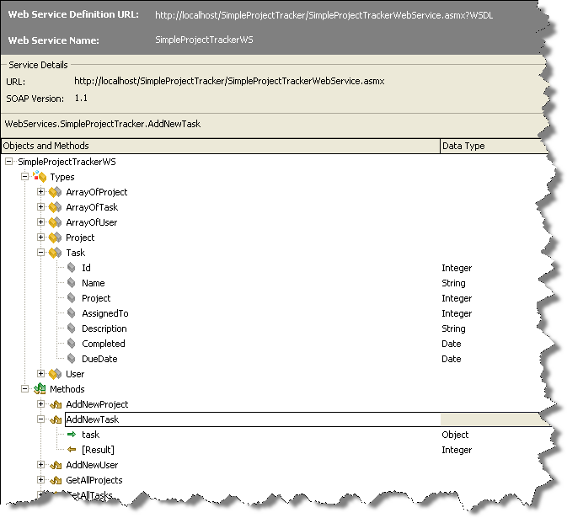
Web Service Objects and Methods

Slide 21
Web Service testing – with COM
‘Example with known Web Service URL and XML Request – no need for Web Service project item
Set WinHttpReq = CreateObject("WinHttp.WinHttpRequest.5.1")
WinHttpReq.Open "POST", "http://servername:25000/node/test", False
Set xmlDoc = CreateObject("Msxml2.DOMDocument")
'loadXML
xmlDoc.load( C:\test1.xml)
'Send request
WinHttpReq.Send xmlDoc
'Get XML Response
XMLResponse = WinHttpReq.ResponseText
msgbox XMLResponse

Slide 22
Unit Testing
TestComplete can be integrated with:
DUnit - A unit test framework for Delphi Applications.
JUnit - A standard unit test framework for Java Applications.
MSTest - A unit test framework designed by Microsoft for unit testing .NET applications, comes with Visual Studio 2008 and Visual Studio 2005 Team Edition.
NUnit - An open-source unit test framework based on JUnit, used for unit testing .NET applications.

Slide 23
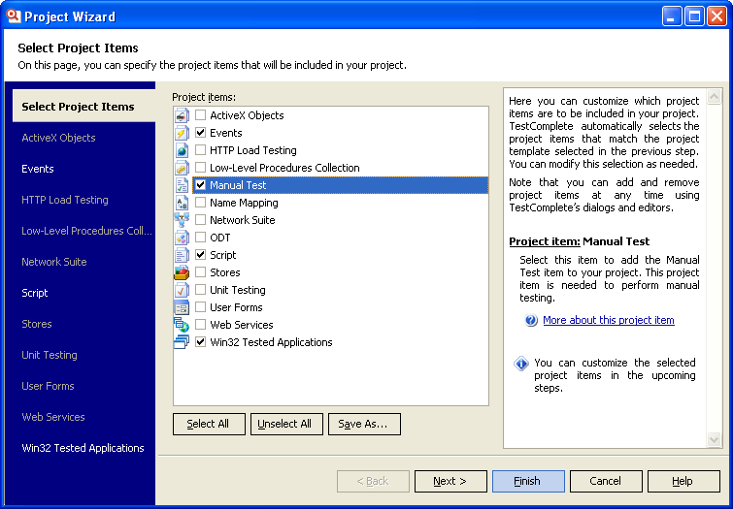
Manual Testing

Slide 24
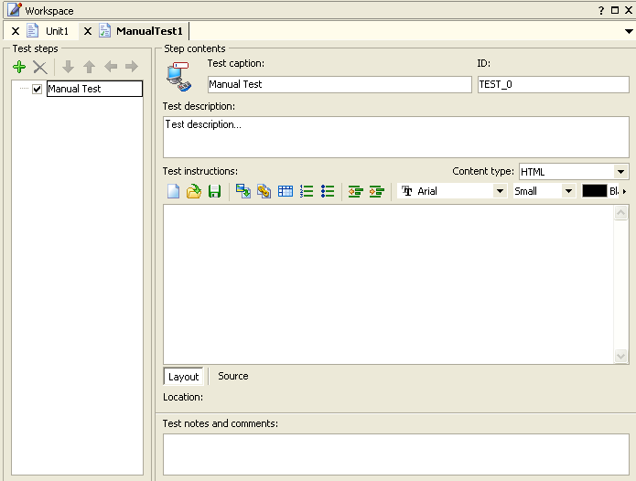
Create a Manual Test

Slide 25
Distributed Testing
Distributed Testing is the ability of TestComplete to control test cases running on several computers at the same time
In addition to running the tests, the computers involved can communicate with each other using TestComplete.

Slide 26
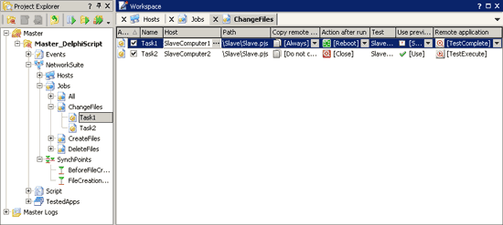
Distributed Testing with TestComplete and TestExecute

Slide 27
3. TestComplete vs. HP/Mercury QTP
(a brief comparison)
PLEASE NOTE: THIS SECTION IS ONLY MY OPINION.

Slide 28
TestComplete vs. QTP (Slide 1)
 | Test Complete | QTP
Test Management | Yes. Built in. | No. Needs Quality Center
Cost | $2K Enterprise Seat License | $8K Seat License
Separate Test Execution Module | Yes. $200 – TestExecute | No. Must use Full QTP install.
User Community | Medium | Biggest by far
Ease of use | Programming background is highly recommended | Good for beginners. However, Programming background is needed for advanced automation

Slide 29
TestComplete vs. QTP (Slide 2)
 | Test Complete | QTP
Support | Excellent. AutomatedQA personnel actively participates in QAForums | Improving. Knowledge Base access is restricted to Paid subscribers
Support Cost | 20% of Purchase price | 20% of Purchase price
Scripting Languages | VBScript, Jscript, C# Script, C++ Script, Delphi Script | VBScript
Version Control Integration | Yes | Via Quality Center only.
Descriptive Programming | Limited | Very good

Slide 30
TestComplete vs. QTP (Slide 3)
 | Test Complete | QTP
Web Testing | Yes. IE, Firefox | Yes. IE (good), Firefox (limited)
Manual Testing | Yes | No. It is Quality Center functionality
Web Load/Performance Testing | Yes | No. This is LoadRunner functionality
Web Services Testing | Yes | Yes
Unit Testing Integration | DUnit, JUnit, NUnit, MSTest | No. It can be done only in Quality Center.

Slide 31
TestComplete vs. QTP (Slide 4)
 | Test Complete | QTP
.NET testing | Yes | Yes
PowerBuilder Testing | Limited | Yes
Delphi Testing | Yes | Yes
VB Testing | Yes | Yes
C++ Testing | Yes | Yes

Slide 32
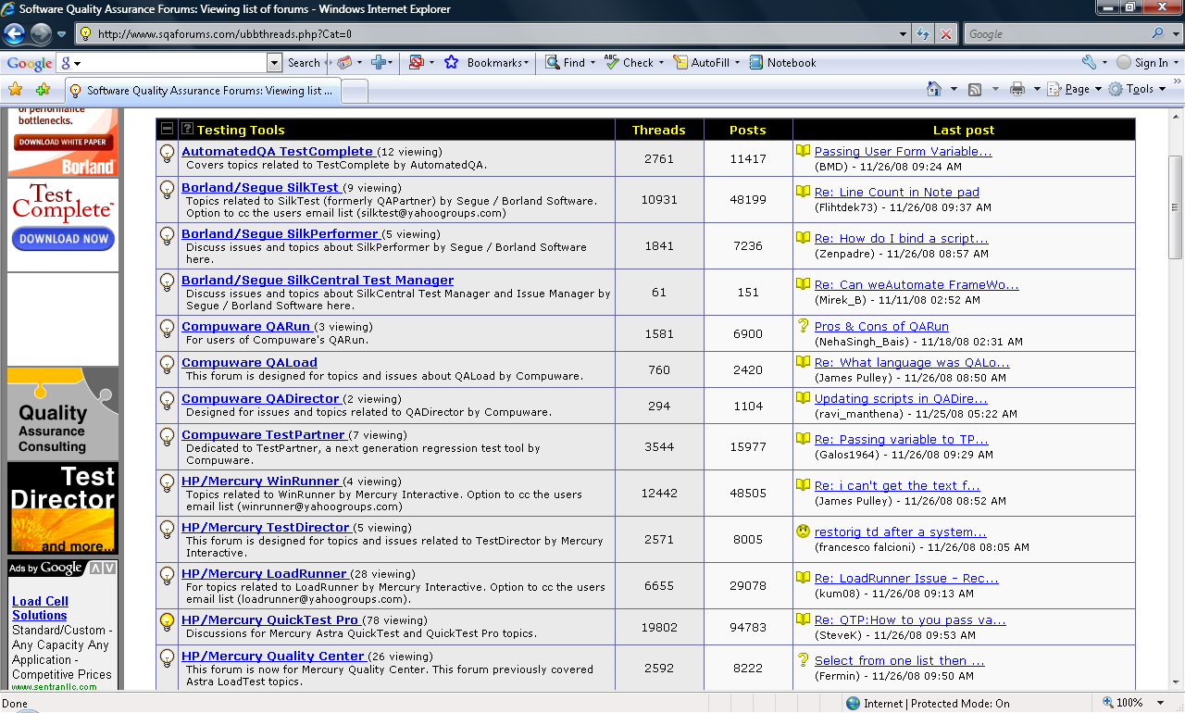
QAForums.com Visitors/Treads/Posts

Slide 33
4. Data/Keyword-driven automation

Slide 34
Data Driven Plug-In (DDT)
DDT uses ADO to access different data elements, such a text files, Excel Spreadsheets, or any ADO compatible database.
DDT plug-in supports the creation of three different types of drivers, CVSDriver, ExcelDriver, and ADODriver

Slide 35
DDT Example for DB
SQLStatement = "SELECT TOP (100) CustomerID, FirstName, LastName FROM Sales.vIndividualCustomer"
ConnectionString = "Provider=SQLOLEDB.1;Integrated Security=SSPI;" & _
"Persist Security Info=False;" & _
"Initial Catalog=AdventureWorks;Data Source=.\SQLExpress"
' Create Driver
Set MyDriver = DDT.ADODriver(ConnectionString,SQLStatement)

Slide 36
Accessing Excel with COM
(Not DDT)
' Retrieves Worksheets names starting with 2nd worksheet
Function Excel_GetWorksheetNames(sFilename)
intSize =0
Set objExcel = CreateObject("Excel.Application")
Set objWorkbook = objExcel.Workbooks.Open(sFilename)
objExcel.Visible = True
For Each objWorksheet in objWorkbook.Sheets
If intSize<>0 Then ' skipping first worksheet
ReDim Preserve arrNames(intSize-1)
arrNames(intSize-1) = objWorksheet.Name
End If
intSize = intSize + 1
Next
objExcel.Quit
…

Slide 37
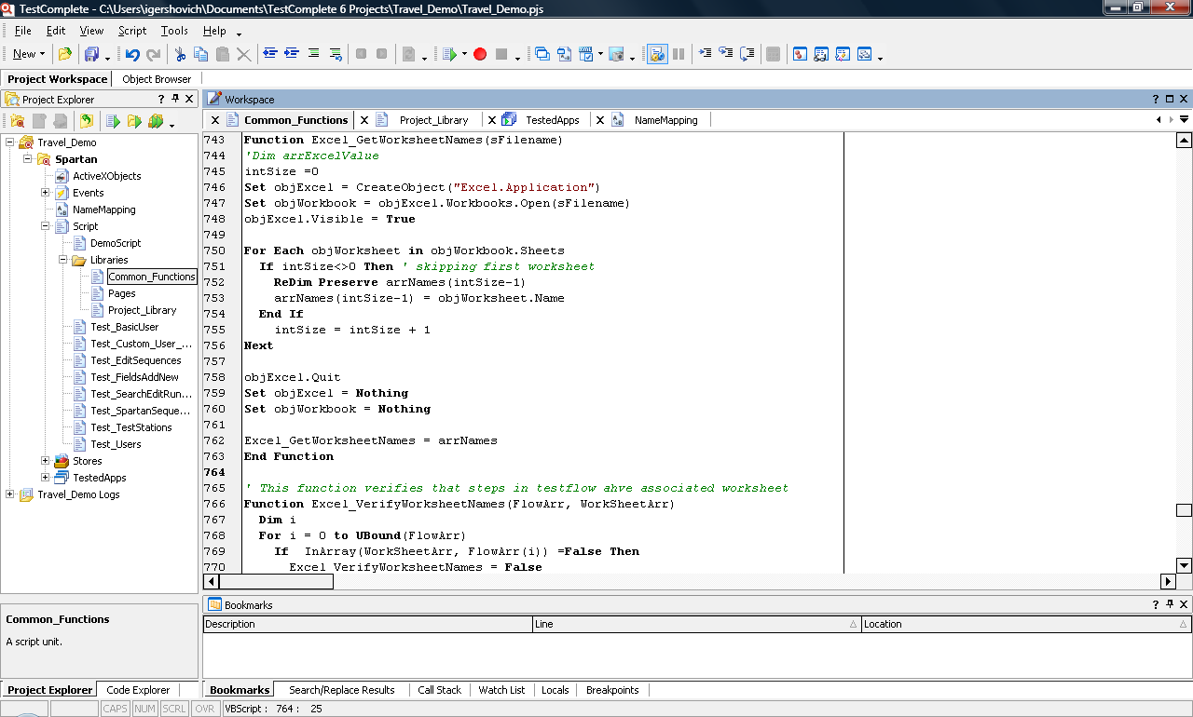
Demo Project Snapshot

Slide 38
Resources
“TestComplete Made Easy” by Lino Tadros - Falafel Software Inc
“TestComplete: A very brief review” blog by Theo Moore (http://geekswithblogs.net/tmoore/archive/2008/11/12/126972.aspx )
TestComplete Help System by AutomatedQA

Slide 39
Igor Gershovich
E-Mail: igershovich@connectedtesting.com
Phone: 720-933-9395
Website: www.connectedtesting.com

